Slide 1

Breast Cancer Diagnosis in Wisconsin
Presented by : Ashish Gupta
Using the magical ingredients of Spark and Scala!

Slide 2

Agenda for Today
01
02
Exploratory Analysis
What is the story behind the data?
Business Case
Dimensionality Reduction
What is the dataset about? What is the Y?
Was the data multi dimensional, Did the reduction help?
03
And the award goes to?
ROC, Accuracy, Confusion Matrix
05
Model Dev.
04
Random Forest, Logistic Regression & more

Slide 3


Hey Our Director wants us to do AI with Breast Cancer Data. Lets do it?
Wait!! What!! Hold on, What is our Business Case.
Dr. Linde, MD
Dr. Sindy, PHD
Story of Lindy and Sindy

Slide 4
Business Case
Features define the characteristics of the cell nuclei.
Y : Diagnosis (M = Malignant Cancer, B = Benign Tumor)
X : computed for each cell nucleus including radius, texture, area etc.
The mean, standard error and worst were computed for each image
Total : 30 Features
Class distribution: 357 benign, 212 malignant
Notes:
Features are computed from a digitized image of a fine needle size of a breast mass
The variables are
a) radius (mean of distances from center to points on the perimeter)
b) texture (standard deviation of gray-scale values)
c) perimeter
d) area
e) smoothness (local variation in radius lengths)
f) compactness (perimeter^2 / area - 1.0)
g) concavity (severity of concave portions of the contour)
Worst is the (mean of the three largest values)
h) concave points (number of concave portions of the contour)
i) symmetry
j) fractal dimension ("coastline approximation" - 1)

Slide 5
Lets get the model up and running!!
Wait!! What!! I need to analyze our data first.
Dr. Lindy, MD
Dr. Sindy, PHD
Story of Lindy and Sindy Continues..

Slide 6
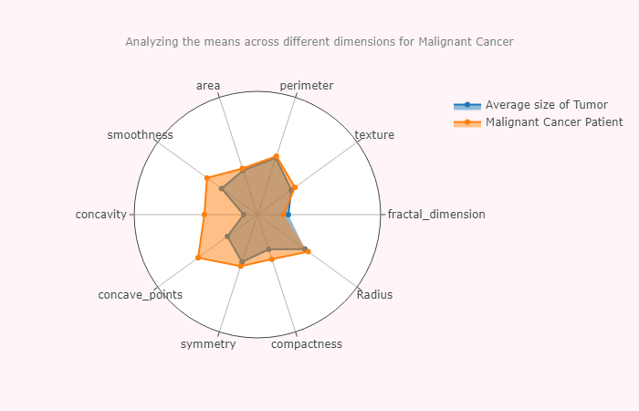
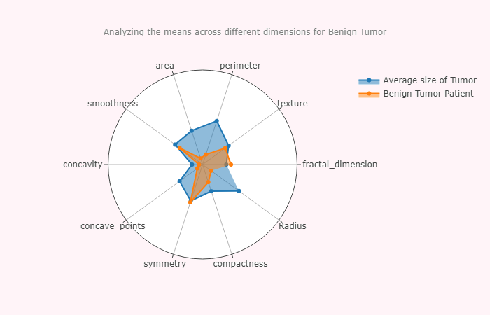
Exploratory Analysis - Means
Notes:
I obviously knew that for every x variable, the worst scenario values will be higher than mean and standard error. So performing exploratory data analysis was a challenge. The goal was to find some key variables that differentiate Benign tumor to Malignant Cancer.

Slide 7
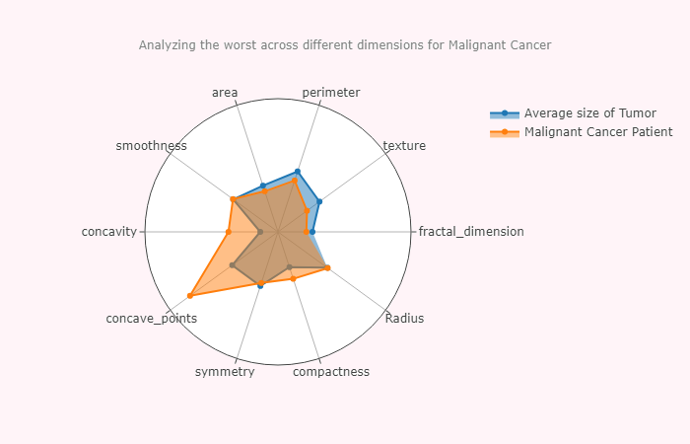
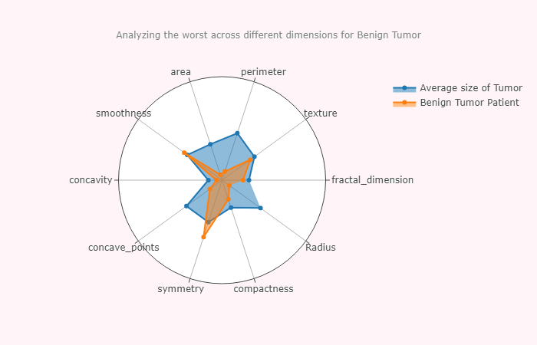
Exploratory Analysis - Worst
Notes:
I obviously knew that for every x variable, the worst scenario values will be higher than mean and standard error. So performing exploratory data analysis was a challenge. The goal was to find some key variables that differentiate Benign tumor to Malignant Cancer.

Slide 8
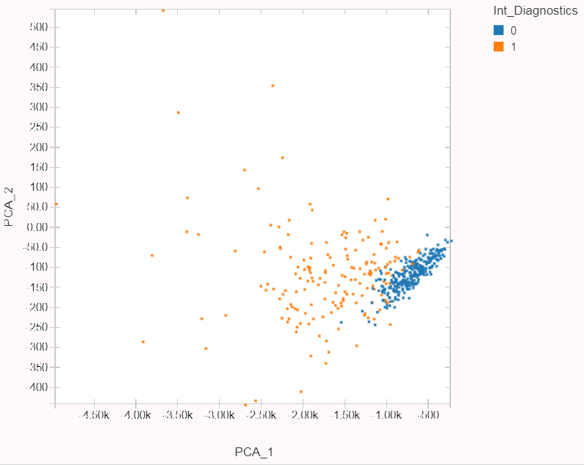
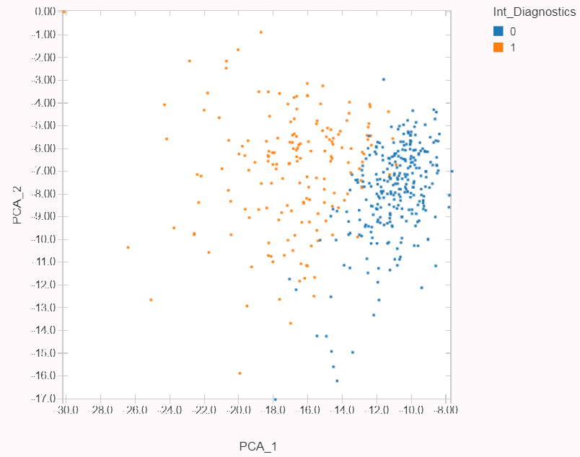
Dimensionality Reduction
How Standard Scaler improves the PCA’s classification
Notes:
Once the important variables were identified, the next step was to apply standard Scaler to standardize the features. I also applied PCA to reduce the existing dimensionality, However it resulted in lower accuracy – indicating that some important features were lost.

Slide 9
I want to see the AI Happening, Lets do it.
She thinks this is a cake walk!! ☹
Dr. Lindy, MD
Dr. Sindy, PHD
Story of Lindy and Sindy Continues…

Slide 10
Model Development
XG BOOST
Light GBM
Random Forest
Logistic Regression
Best Model
XG BOOST
Random Forest
LIGHT GBM
Logistic Regression
Training Accuracy : 97.5
Validation Accuracy : 95.54
Test Accuracy : 90.10
Training Accuracy : 99.24
Validation Accuracy : 94.26
Test Accuracy : 96.29
Training Accuracy : 1.0
Validation Accuracy : 95.21
Test Accuracy : 96.88
Training Accuracy : 97.60
Validation Accuracy : 93.66
Test Accuracy : 97.46

Slide 11
The Winner is Support Vector Classifier
Wow. Amazing – Finally I can show something to our Director!! We did it!! What else do you know?
SVC is my best model, Training Accuracy : 97.06 Validation Accuracy : 95.21
Test Accuracy : 99.36
Dr. Lindy, MD
Dr. Sindy, PHD

Slide 12
Confusion Matrix : SVC
Training Set
Validation Set
Test Set
Predicted
Predicted
Predicted
1
0
1
0
1
0
126
3
36
1
41
1
1
1
1
Actuals
6
222
Actuals
3
52
Actuals
0
78
0
0
0
Precision: 0.95
Recall: 0.36
Precision: 0.92
Recall: 0.40
Precision: 1
Recall: 0.34
Notes:
True positives are how often the model correctly predicted a tumour was malignant
False positives are how often the model predicted a tumour was malignant when it was benign
False negatives indicate how the model correctly predicted a tumour was benign
False Positive indicate how often the model predicted a tumour was benign when in fact it was malignant
Precision = TP / ( TP + FP), Recall = TP / (TP + FN)

Slide 13

Thank you!
https://github.com/RoyMachineLearning
@
ashish.gupta@queensu.ca

